Slide 1


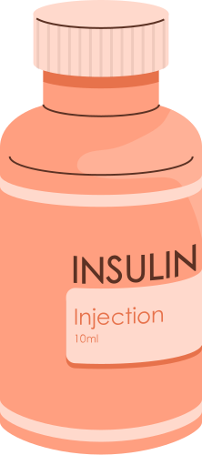
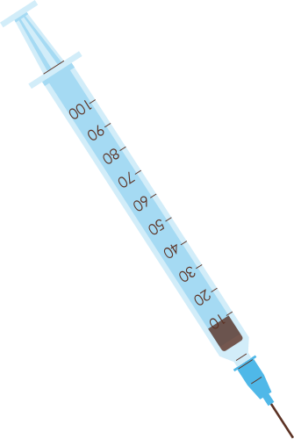

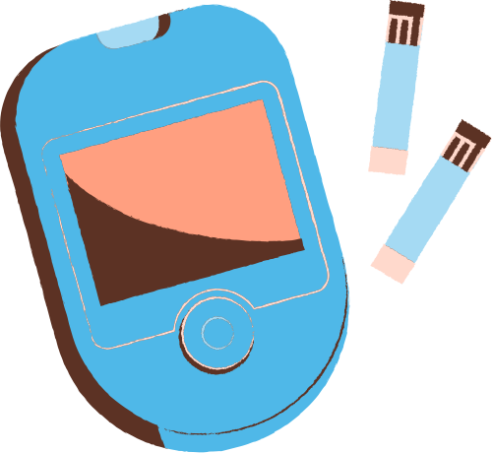

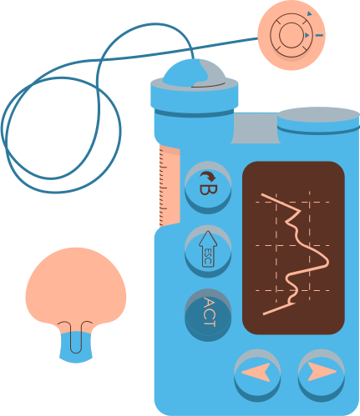
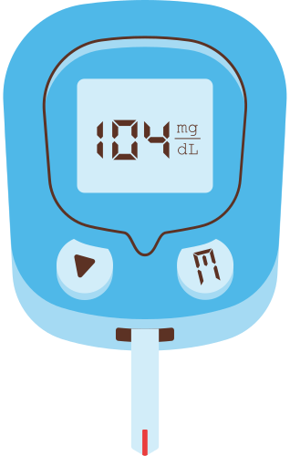

PIMA INDIANS DIABETES
GlucoMetrics Health
Siri Bandreddy, Kem Hosoya, Sreeya Kalari,
Joanne Mittapalli, Mia Saavedra
Notes:
Intro - All

Slide 2

AGENDA
Company introduction
Public health challenge
Dataset Overview
Risk Factor Analysis & Discussion
Recommendations
Notes:
Kem? Either works

Slide 3

ABOUT OUR TEAM
Data Science Consulting Team at GlucoMetrics Health
Analyze diabetes risk factor data from a landmark epidemiological study of the Pima Indian population
Notes:
Joanne

Slide 4
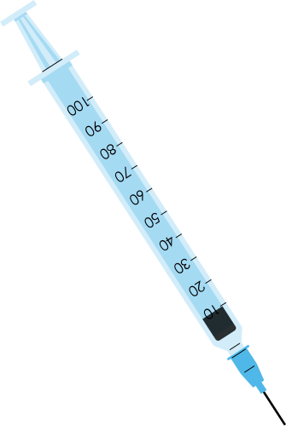
TASK
Client: Public Health Department
Developing Diabetes Prevention Program
Data Given: Pima Indians Diabetes Database
Longitudinal, epidemiological Study
Data collection began in the mid-1960s
Objectives
Identify which risk factors best predict diabetes
See which factors are modifiable
Make appropriate recommendations
Notes:
Joanne

Slide 5
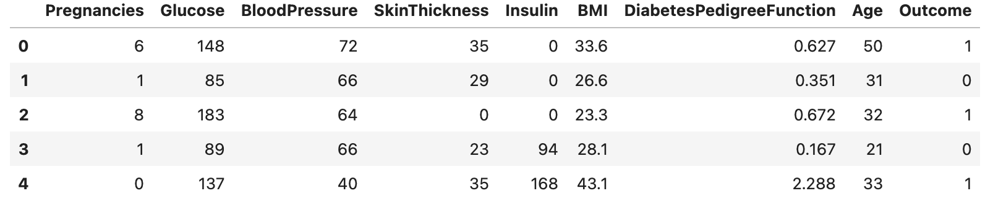
Pima Indians Diabetes Database
Source: National Institute of Diabetes and Digestive and Kidney Diseases
Observations: 768 female Pima Indian Heritage patients (21+) living near Phoenix, Arizona, USA
Variables: Several independent variables, one dependent variable (outcome)
Unique Feature: Diabetes Pedigree Function (DPF) is unique feature of dataset
Notes:
Joanne

Slide 6
PUBLIC HEALTH CHALLENGE
Diabetes is a chronic disease that occurs either when the pancreas does not produce enough insulin or when the body cannot effectively use the insulin it produces (World Health Organization, 2024).
Pima Indians have the highest recorded prevalence and incidence of non-insulin-dependent diabetes mellitus globally
(Knowler et al., 1978; King and Rewers, 1991)
The prevalence of diabetes for Native Americans is higher for women than for men (rates vary among tribes)
Notes:
Kem
https://www.ncbi.nlm.nih.gov/books/NBK233089/

Slide 7

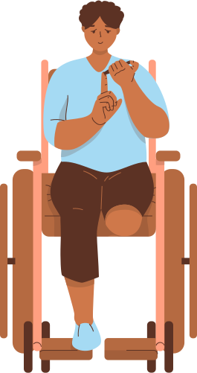

DEEP DIVE
INTO THE DATASET

Slide 8
Variables and Data Types
Pregnancies: Number of times pregnant
Glucose: Plasma glucose concentration after a 2-hour oral glucose tolerance test (mg/dL)
BloodPressure: Diastolic blood pressure (mmHg)
SkinThickness: Tricep skinfold thicknesss (mm)
Insulin: 2-hour serum insulin (µU/mL)
BMI: Body mass index (weight in kg / height in m²)
DiabetesPedigreeFunction: A numeric score used to estimate an individual's genetic risk of developing type 2 diabetes based on their family history (Zhang, 2025)
Age: Age of the patient in years
Outcome: 0 = No diabetes, 1 = Diabetes
Notes:
Sreeya

Slide 9

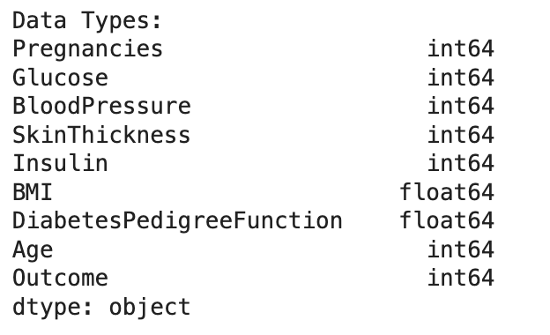
10 - Point Inspection
Shape: 768 observations and 9 features (6,912 total data points)
Columns: 9 total columns
Data Type: All variables were int64, except BMI and DPF (float64)
First Look: Noticed values that look like placeholders for missing data
Last Look: Data ended cleanly and remains consistent
Notes:
Sreeya

Slide 10
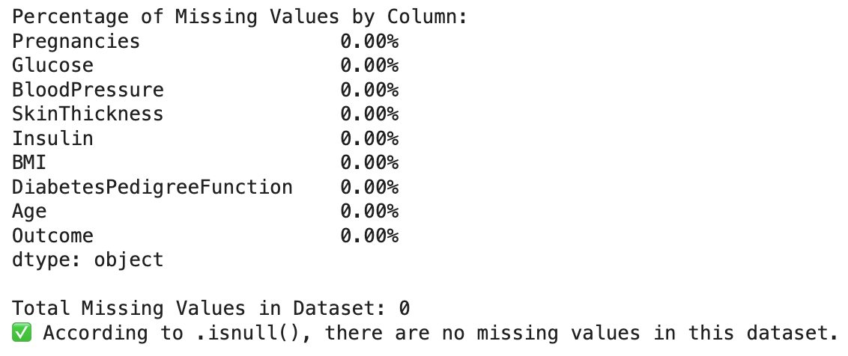
10 Point Inspection
Memory Usage: 0.06 MB, very small dataset
Missing Values: No missing values according to .isnull( )
Duplicates: No duplicates
Descriptive Statistics: Identified ranges and min values of 0 representing biologically impossible measurements
Unique Values: All features had high cardinality, except outcome (binary).
Notes:
Sreeya

Slide 11
Challenges with Dataset
This dataset uses 0 to represent missing values
Standard .isnull( ) checks would not detect these as missing
Handled by:
Identifying which columns where 0 is biologically impossible
Glucose, BloodPressure, SkinThickness, Insulin, BMI
Replacing impossible zeroes with NaN (placeholder for missing data)
Analyzing only non-zero values
Notes:
Siri

Slide 12
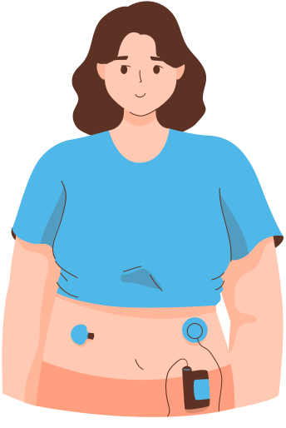
RISK FACTOR ANALYSIS

Slide 13
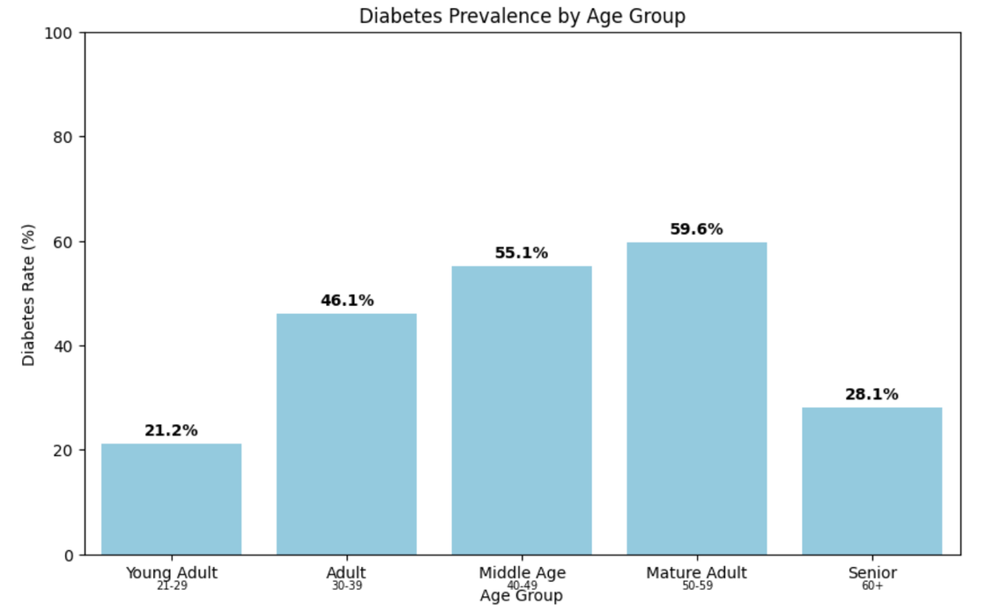
Age
Sharp increase from Young Adults (21.21%) to Adults (46.06%)
Prevalence continues to rise with age before declining in Seniors
Overall pattern supports research that diabetes risk increases with age
Higher prevalence with age may reflect increased insulin resistance and accumulated health risk factors.
Notes:
Mia

Slide 14
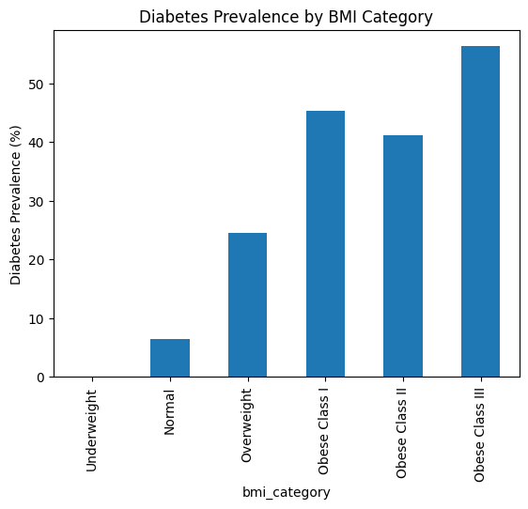
BMI
Normal weight individuals have very low prevalence (~6%).
Obese Class III is the highest (~56%).
A substantial increase in risk beginning at BMI ≥ 25.
Diabetes prevalence increases steadily as BMI category increases.
The evidence suggests that BMI is a significant risk factor for diabetes in this population.
Notes:
Siri

Slide 15
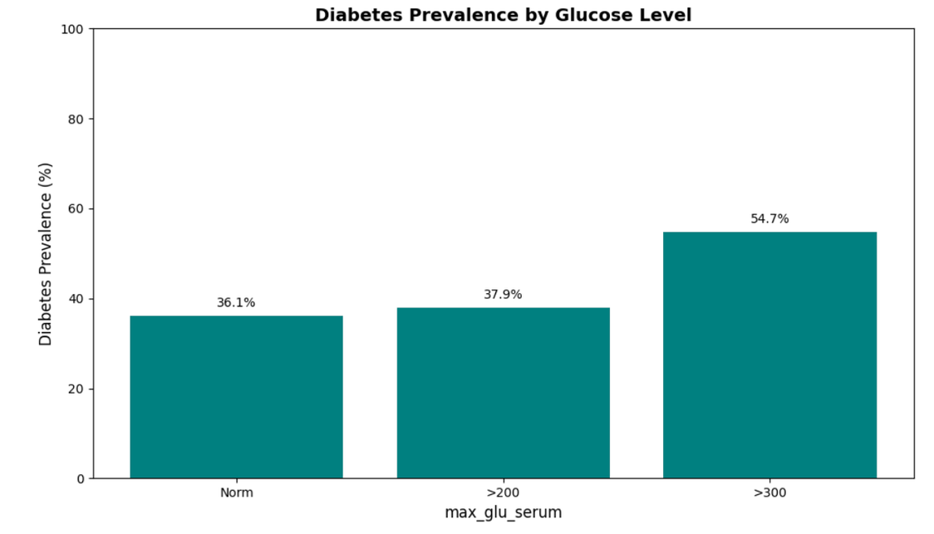
Glucose
Normal glucose individuals have moderate prevalence (~36%).
>300 is the highest (~55%).
Diabetes prevalence increases as glucose level increases.
As the insulin levels rise, glucose rise is also correlated.
The evidence suggests that glucose level is a significant risk factor for diabetes in this population.
Notes:
Joanne

Slide 16
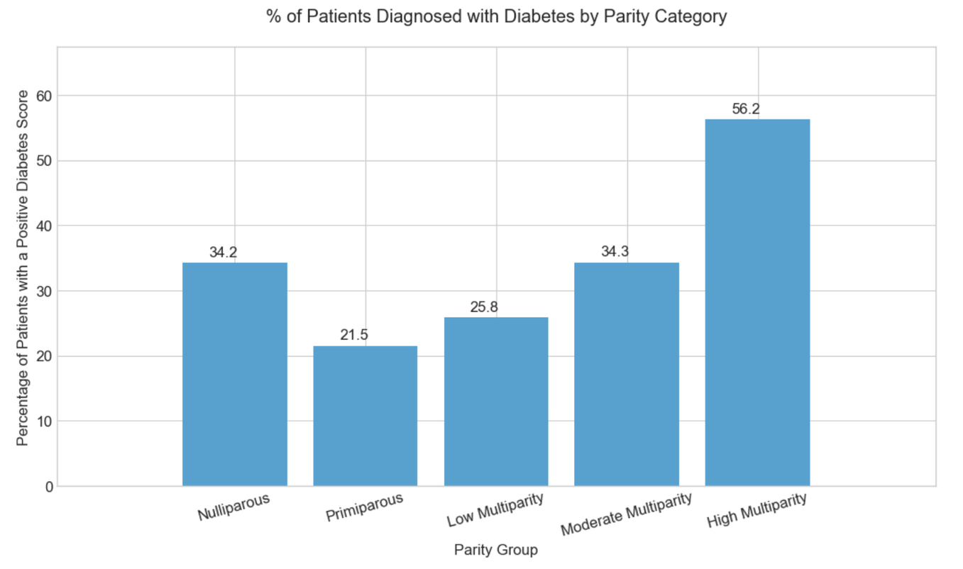
Pregnancy
Individuals diagnosed with diabetes increases to 56.2% for people with 7+ pregnancies.
After 1 pregnancy, the possibility of the individual being diagnosed with diabetes gradually increases, suggesting a correlation of the two values.
Notes:
Kem

Slide 17
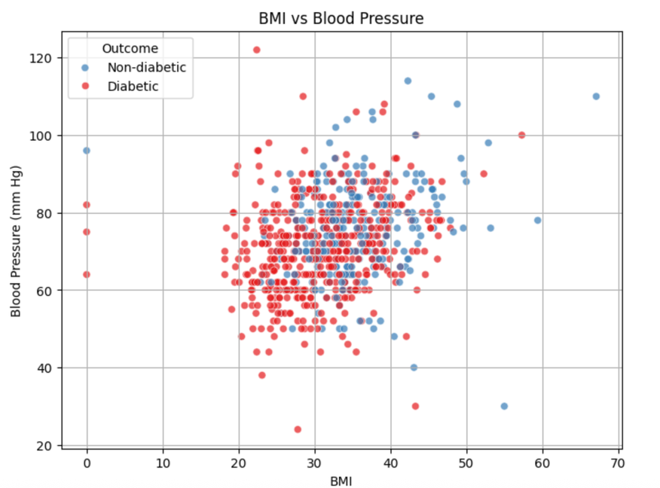
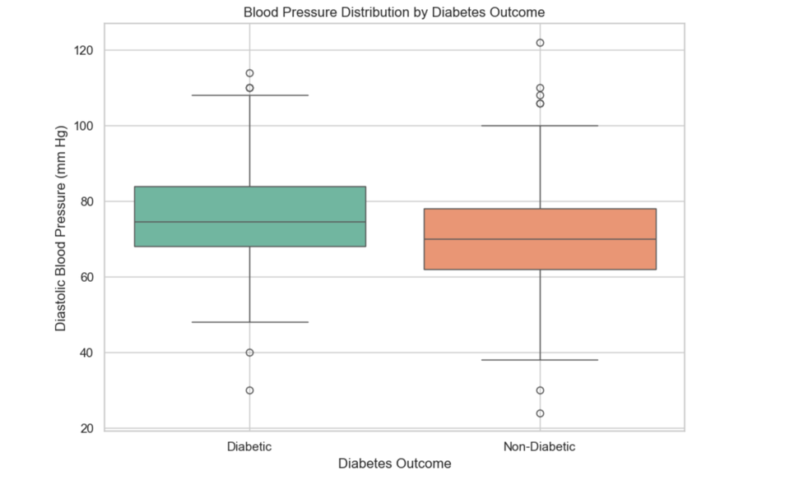
Blood Pressure
BMI vs Blood Pressure
Blood Pressure vs Diabetes Outcome
Individuals with higher blood pressure are more likely to have diabetes
46.8% of individuals with higher blood pressure, had diabetes vs 31.7%
Notes:
Sreeya

Slide 18
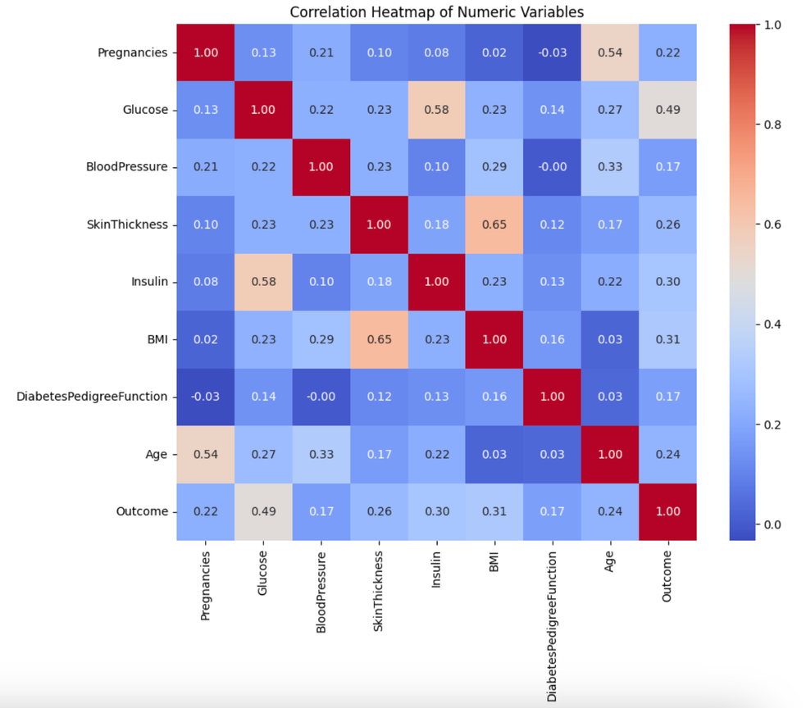
WHICH RISK FACTORS ARE THE STRONGEST?
Strongest Risk Factors
(Correlation with Diabetes Outcome):
Glucose (r = 0.49)
BMI (r = 0.31)
Insulin (r = 0.30)
Glucose is more strongly associated with diabetes outcome than other measured risk factors.
Notes:
Mia

Slide 19
HOW DO RISK FACTORS INTERACT?
BMI ↔ Insulin ↔ Glucose: Higher BMI increases insulin resistance, raising blood glucose levels.
Age ↔ Insulin: Increasing age reduces insulin sensitivity and adds metabolic strain.
Pregnancies ↔ Glucose: More pregnancies (especially with gestational diabetes) increase later glucose dysregulation risk.
Metabolic Syndrome: High BP, high BMI, insulin resistance, and abnormal glucose often cluster together.
(Mayo Clinic, 2025)
Notes:
Joanne

Slide 20

WHICH RISK FACTORS ARE MODIFIABLE?
BMI: diet, exercise, weight management
Glucose levels: diet, exercise, medication
Blood pressure: diet, exercise, medication
Insulin levels: diet, exercise, weight management, medication
Age and Pregnancies are non-modifiable
(American Heart Association, 2024)
Notes:
Siri

Slide 21
RECOMMENDATIONS

Slide 22
WHAT SHOULD THE PREVENTION PROGRAM PRIORITIZE?
Primary Focus: Glucose control and BMI reduction
Strongest correlations + highly modifiable
Secondary Focus: Improve insulin sensitivity through lifestyle intervention
Target High-Risk Groups: Older adults and women with multiple pregnancies
Overall Strategy: Emphasize sustainable diet, physical activity, and early screening
Notes:
Mia

Slide 23
PROPOSED DIABETES PREVENTION PROGRAM
Lifestyle Intervention: Nutrition education, physical activity, and weight management programs to reduce BMI and improve metabolic health
Screening & Monitoring: Regular glucose, BMI, and blood pressure screenings for early detection and timely clinical intervention
Targeted Outreach: Focus on high-risk groups (older adults, women with multiple pregnancies or history of gestational diabetes)
Ongoing Support: Health coaching, behavioral counseling, and digital tracking tools to promote long-term habit change
Notes:
Siri

Slide 24
WHAT ARE THE LIMITATIONS?
Missing Risk Factors:
No data about diet, exercise, medication, or socioeconomic factors
Small sample size & Limited Representation:
Only 768 records of female Pima Indians aged ≥21; findings may not generalize to males or other populations
Fewer diabetes cases than non-diabetes cases, limiting statistical power and model performance without adjustment
Binary Outcome Only
No diabetes types or severity data, restricting deeper analysis
Current analysis does not capture interactions between risk factors or predictive modeling capacity.
Notes:
Kem

Slide 25
CONCLUSION
Glucose and BMI were the strongest risk factors associated with diabetes outcome.
Modifiable factors (BMI, glucose, insulin, blood pressure) present key opportunities for prevention.
Age and pregnancy history help identify high-risk groups for targeted screening.
Future Work
Develop predictive models to assess interactions among risk factors.
Evaluate how well risk factors predict diabetes beyond simple correlations.
Notes:
All

Slide 26
SOURCES
AMERICAN HEART ASSOCIATION. (2024). DIABETES RISK FACTORS. WWW.HEART.ORG. HTTPS://WWW.HEART.ORG/EN/HEALTH-TOPICS/DIABETES/UNDERSTAND-YOUR-RISK-FOR-DIABETES
KING, H., & REWERS, M. (1991). DIABETES IN ADULTS IS NOW A THIRD WORLD PROBLEM. THE WHO AD HOC DIABETES REPORTING GROUP. BULLETIN OF THE WORLD HEALTH ORGANIZATION, 69(6). HTTPS://PUBMED.NCBI.NLM.NIH.GOV/1786615/
‌
KNOWLER, W. C., BENNETT, P. H., HAMMAN, R. F., & MILLER, M. (1978). DIABETES INCIDENCE AND PREVALENCE IN PIMA INDIANS: A 19-FOLD GREATER INCIDENCE THAN IN ROCHESTER, MINNESOTA. AMERICAN JOURNAL OF EPIDEMIOLOGY, 108(6), 497–505. HTTPS://DOI.ORG/10.1093/OXFORDJOURNALS.AJE.A112648
MAYO CLINIC. (2025). METABOLIC SYNDROME: INCREASED RISK OF CARDIOVASCULAR DISEASE, DIABETES-METABOLIC SYNDROME - SYMPTOMS & CAUSES - MAYO CLINIC. MAYO CLINIC. HTTPS://WWW.MAYOCLINIC.ORG/DISEASES-CONDITIONS/METABOLIC-SYNDROME/SYMPTOMS-CAUSES/SYC-20351916?UTM=
UCI Machine Learning. (2016). Pima Indians Diabetes Database. Kaggle.com. https://www.kaggle.com/datasets/uciml/pima-indians-diabetes-database
WORLD HEALTH ORGANIZATION. (2024, NOVEMBER 14). DIABETES. WHO.INT; WORLD HEALTH ORGANIZATION: WHO. HTTPS://WWW.WHO.INT/NEWS-ROOM/FACT-SHEETS/DETAIL/DIABETES
ZHANG, W. (2025). DIABETES DETECTION: PREDICTING TYPE II DIABETES WITH MACHINE LEARNING ALGORITHM. PROCEEDINGS OF THE 2025 INTERNATIONAL CONFERENCE ON HEALTH BIG DATA, 16–22. HTTPS://DOI.ORG/10.1145/3733006.3733009
‌

Slide 27
THANK YOU!
Do you have any questions, comments, or suggestions?

